Slide 1

Hanabi
Akshara Balachandra, Henry Walter, Albert Huang

Slide 2
Development Team
Akshara Balachandra
Coder, JUnit testing, Paperwork (Status reports, specifications), networking
Albert Huang
Coder, JUnit testing, networking
Henry Walter
Coder, GUI components, Documentation

Slide 3
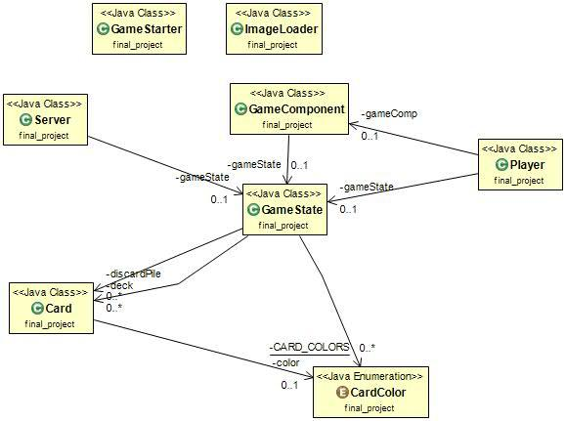
UML Class Diagram

Slide 4
Game Demonstration and Code Showcase

